Slide 1
Luther Luxembourg
Banking & Finance

Slide 2
Content
            Luther at a glance
            Luther Luxembourg
            Experience
            Key Contacts

Slide 3
Luther at a glance

Slide 4

Hits the mark. Luther.
Luther stands for expertise and dedication. With enthusiasm for our profession and the matter at hand, we work out precise answers to your questions. We provide our clients with the best possible solution. Not too much and not too little – our advice always hits the mark.
We are aware of the importance of using resources efficiently and giving priority to sustainable and forward-looking planning. Therefore, we always keep an eye on the economic and financial effects of our advice. This applies both to controversial disputes as well as to structuring advice.
Luther has been named “Law Firm of the Year: Germany 2021” and also “European Law Firm of the Year 2021” by The Lawyer, one of the most well-known legal magazines worldwide.
Lawyers and tax advisors
Locations
Long-standing connections to commercial law firms worldwide
Offices in international financial centres and investment locations
420
21

Slide 5
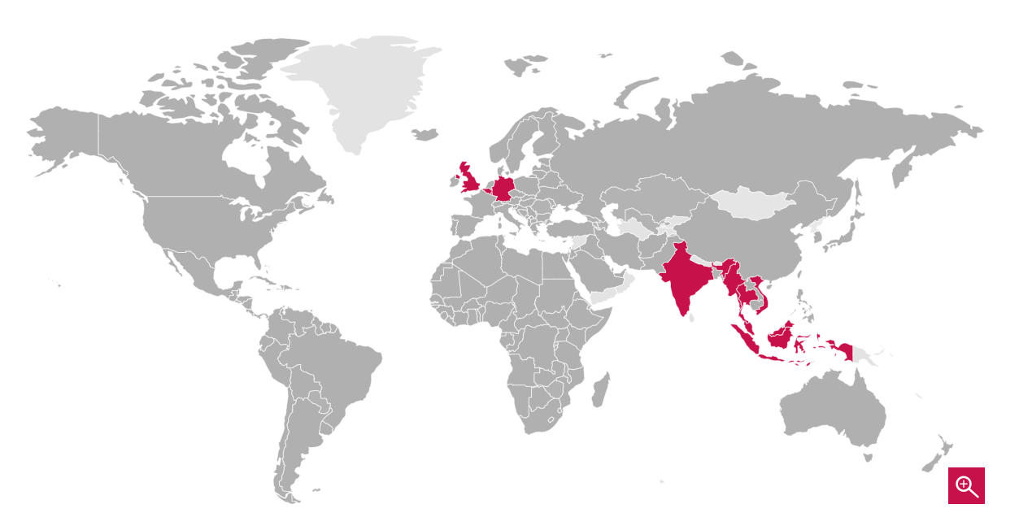
Our locations
We have a global outlook, with international offices in 10 key economic and financial centres in Europe and Asia. We also maintain close relationships with other commercial law firms in all relevant jurisdictions. Luther is a founding member of unyer (www.unyer.com), a global organisation of leading professional services firms that cooperate exclusively with each other. This way, we ensure a seamless service for our clients throughout their demanding international projects.
Our locations
Bangkok
Berlin
Brussels
Cologne
Delhi-Gurugram
Dusseldorf
Essen
Frankfurt a.M.
Hamburg
Hanover
Ho Chi Minh City
Jakarta
Kuala Lumpur
Leipzig
London
Luxembourg
Munich
Singapore
Stuttgart
Yangon
Luther locations
Best Friends

Slide 6


About unyer
unyer, founded by Luther and Fidal in 2021, is a global organisation of leading international professional services firms. Besides law firms, unyer is also open to other related professional services, especially from the legal tech sector. unyer is based in Zurich as a Swiss Verein. unyer is globally connected but has strong local roots in their respective markets.
unyer has an exclusive approach and only accepts one member firm from each market. unyer members offer its clients full services across all jurisdictions with a compelling industry focus. The organisation has an annual turnover of more than EUR 650 million and includes over 2,550 lawyers and advisors in more than 14 countries in Europe and Asia. In September 2021, Pirola Pennuto Zei & Associati joined the international organisation. In the spring of 2023, the Austrian law firm KWR joined the group.
www.unyer.com

Slide 7
Luther Luxembourg

Slide 8
Luther in Luxembourg
2010 - Luther opened for business in Luxembourg
Over 28 lawyers, including 8 partners
Clients benefit from our services in:
    Corporate Law and M&A
    Investment Management
    Banking, Finance and Capital Markets
    Employment
    Dispute Resolution
    Real Estate
    Insurance and Reinsurance
Regularly ranked in Legal500, Chambers & Partners, and IFLR1000.
Longstanding client base of renowned domestic and international clients across various markets:
    Multinational groups
    International Investment Banks
    Professionals of the financial sector
    Mid-sized privately held companies
    Regulated Management Companies
    Fund sponsors of PE/RE
    Family offices
    HNWI
    Financial intermediaries
  Longstanding collaboration with Atoz Tax Advisers to provide tax advisory services.

Slide 9
Our practices
Corporate Law / M&A
Banking
Finance and
Capital Markets
Data
Privacy
Dispute Resolution
Employment Law
Insurance / Reinsurance Law
Investment Management
Real Estate Law and Property Transactions

Slide 10
Focus on Banking, Finance &
Capital Markets

Slide 11
Banking
Finance and
Capital Markets
Clients benefit from our innovative and tailor-made legal services in:
Banking and finance
Setting-up a new business in Luxembourg
Establishing credit institutions and professionals of the financial sector in Luxembourg;
Advising on the license, authorization and passporting with the relevant supervisory authorities;
Assisting in the establishment of outsourcing of activities to other financial sector professionals;
Legal monitoring and day-to-day assistance in relation to regulatory matters.
Financing new projects on the lending market
Advising on:
  Financing of acquisitions of assets, companies, real estates or debt portfolios;
  Set up of special purpose vehicles;
  Negotiation of term sheets, security packages, and covenants;
  Design and negotiation of lending and security documentation;
  Post-acquisition steps;
  Authorization process with the relevant supervisory authorities;
  Post-issuance related matters (early redemption, conversion of notes, repayment on maturity, etc.).
Finding new alternatives to the lending market
Advising on:
Structuring and implementing alternative financing structures, including securitization and fiduciary issuances;
Structured finance;
Set up of ad hoc vehicles;
Structuring and negotiating financing documentation, including term sheets, subscription agreements, form of notes, risk factors summary, etc.
Regulatory advice
Advising on finance, banking and insurance regulatory matters (European and Luxembourg regulation, local authorities' regulations in banking, finance, insurance, capital market matters, soft regulation);
Review from a regulatory perspective of pre-contractual and contractual documentation in relation to the services offered by credit institution, insurance companies.

Slide 12
Banking
Finance and
Capital Markets
Capital markets
Advising on issuance of high yield bonds, EMTN programmes or commercial paper programmes and structured products including green bonds;
Drafting of offering or information memorandum as well as the EMTN programme as applicable;
Coordinating and liaising with the supervisory authorities and the Luxembourg Stock Exchange;
Soliciting and collecting consents of security holders;
Advising on market transfers, delisting, and exchange offers;
Assisting in all post-issuance regulatory matters.
Recognitions
IFLR1000 2024
Tier 3 in Banking & Finance
Leaders League 2024
Excellent in Banking & Finance
Legal500 2023
Tier 4 in Banking, Finance & Capital Markets

Slide 13


Bangkok, Berlin, Brussels, Cologne, Delhi-Gurugram, Dusseldorf, Essen, Frankfurt a.M.,
Hamburg, Hanover, Ho Chi Minh City, Kuala Lumpur, Jakarta, Leipzig, London, Luxembourg, Munich, Singapore, Stuttgart, Yangon
You can find further information at:
www.luther-lawfirm.com
www.luther-services.com
Legal and Tax Advice | www.luther-lawfirm.com

